Slide 1
MTH1203: Probability and Statistics
Lecture 01 (BSCS, BSDS, BSIT)
Topic: Foundations of Probability
Dr. Daphne Nyachaki Bitalo
Department of Computing & Technology
Faculty of Engineering, Design & Technology
Fri 6th Sept 2024

Slide 2
Lecture Objectives and Learning outcomes
The Objectives of this lecture are :
Understand the basic concepts and principles of events and probability.
Learn about types of probability.
Learn about distribution of probability.
Discuss the various scenarios where probability is applied.
By the end of this lecture, students should be able to
define experiments, spaces and events.
Calculate the probabilities of varying events.
Set up for practical sessions using python.

Slide 3
Lecture Overview
Basic Concepts (events, spaces)
Mathematical theories (axioms)
Types of probability
Random Variables
Probability distributions

Slide 4
Why the probability and statistics?
Uncertainty exists in computer science, in many aspects of data science, business, and our everyday life. It is an objective reality, and one has to be able to deal with it. We are forced to make decisions under uncertainty. Those decisions are reliant on probability.
What are the chances of a home team winning the olympics?
A meteorologist predicts, say, a 60% chance of rain. Why can’t they let us know exactly whether it will rain or not?
An active volcano has suddenly started, and it is not clear where to start evacuation.

Slide 5
Why the probability and statistics?
Probability problems and statistical problems sound different
Example a probability problem
A folder contains 50 executable files. When a computer virus attacks a system, each file is affected with probability 0.2. Compute the probability that during a virus attack, more than 15 files get affected.
Notice that the situation is rather clearly described, in terms of the total number of files and the chance of affecting each file. The only uncertain quantity is the number of affected files, which cannot be predicted for sure.
Example a statistics problem
A folder contains 50 executable files. When a computer virus attacks a system, each file is affected with the same probability p. It has been observed that during a virus attack, 15 files got affected. Estimate p. Is there a strong indication that p is greater than 0.2?
To solve the problem one may provide a point estimator of p, a real number, or may opt to construct a confidence interval of “most probable” values of p.

Slide 6
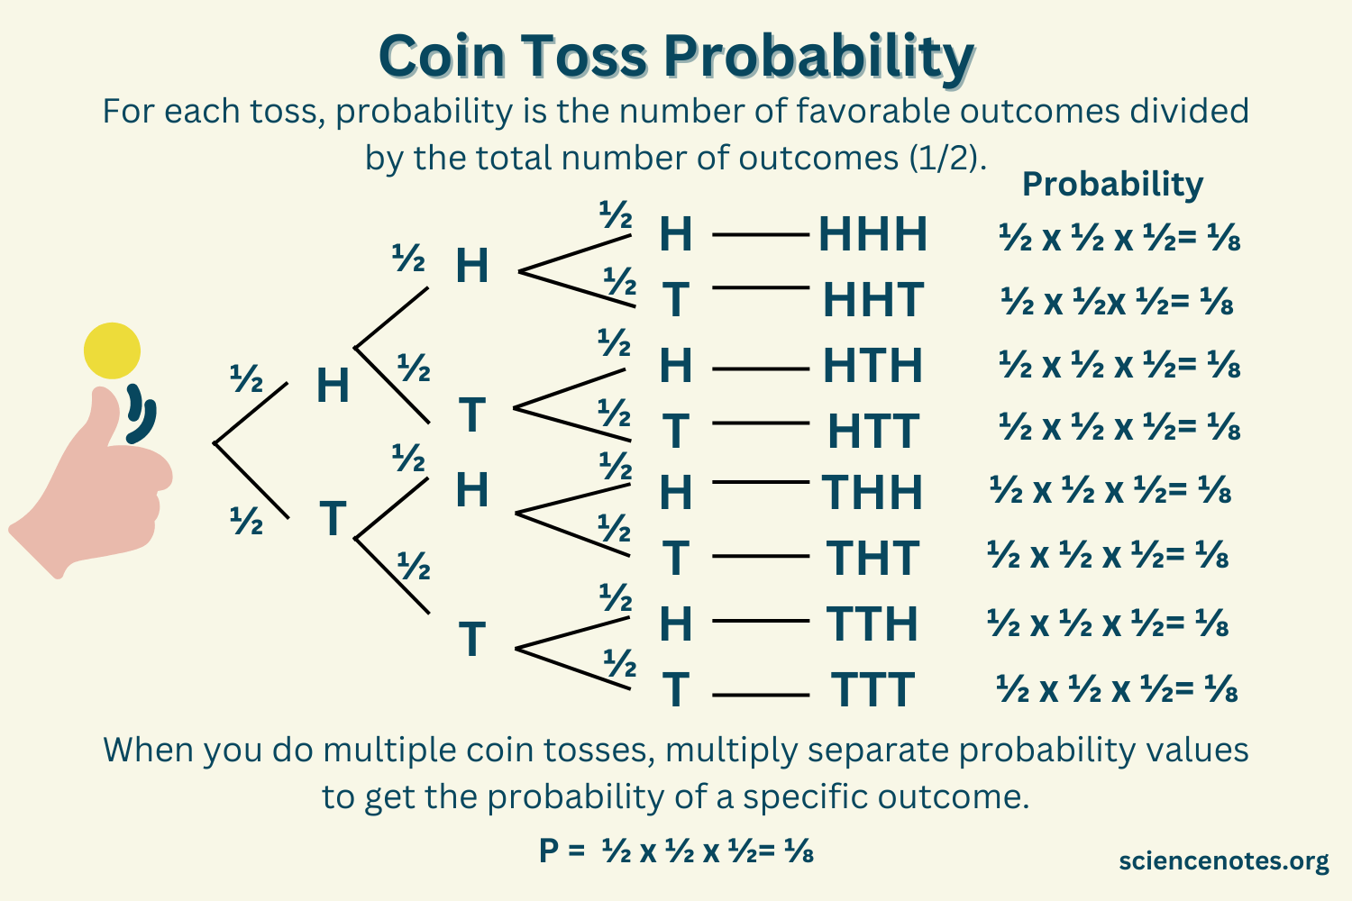
Basic concepts of probability
Experiment
An experiment is any procedure that can result in one or more outcomes. It doesn't necessarily involve a physical action; it can be a mental process or even a theoretical construct.
Examples:
Flipping a coin
Rolling a die
Surveying people about their favorite colour
Observing the weather

Slide 7
Basic concepts of probability
Sample Space (Ω) or (S)
The set of all possible outcomes in an experiment. It's denoted by the symbol S.
Examples:
If you flip a coin, S = {heads, tails}.
If you roll a die, S = {1, 2, 3, 4, 5, 6}.
If you survey 20 people on a set of 5 colours, S = {red, blue, green, yellow, white}X20.
Event (E)
An event is a set of outcomes.
Examples:
Getting a "heads" when flipping a coin is an event.
Rolling an even number on a die is an event.
Predicting the chance of rain tomorrow is an event

Slide 8
Basic concepts of probability
Example
Consider a football game between the Uganda and Kenya. The sample space consists of 3 outcomes, Ω = { Uganda win, Kenya win, they tie }
Combining these outcomes in all possible ways, we obtain the following 2^3 = 8 events: Uganda win, lose, tie, get at least a tie, get at most a tie, no tie, get some result, and get no result. The event “some result” is the entire sample space Ω, and by common sense, it should have probability 1. The event “no result” is empty, it does not contain any outcomes, so its probability is 0.
Example:
The number of events in tossing an even number on a die.
Total Ω = { 1, 2, 3, 4, 5, 6 }
Events of interest(E) = { 2, 4, 6 }
Probability(E) = 3/6

Slide 9
Basic concepts of probability
Example
Consider two parents are carriers of sickle-cell anaemia. Their genetic makeup is AS.
Note the genetic makeup of a non-carrier is AA, and of a diseased child is SS.
The sample space of the parents includes 4 outcomes, Ω = { AA, AS, AS, SS}
Events of interest(E) = { AA, AS, AS }
Probability(E) = 3/4

Slide 10
Basic concepts of probability
Probability is a measure of the likelihood that an event will occur. It is a number between 0 and 1, inclusive.
A probability of 0 means the event is impossible.
A probability of 1 means the event is certain.
A probability between 0 and 1 indicates the event's likelihood lies somewhere in between.
What does a negative probability imply?

Slide 11
Basic concepts of probability
Notation:
P(E) represents the probability of event E.
Example:
If a fair coin is flipped, P(heads) = 0.5, meaning there's a 50% chance of getting heads.
If a die is tossed, P(1) = 1/6, meaning there's a 16.67% chance of getting a 1.
Key Properties of Probability:
Non-negativity: P(E) ≥ 0 for any event E.
Certainty: P(S) = 1, where S is the sample space.
Additivity: For mutually exclusive events A and B, P(A ∪ B) = P(A) + P(B).

Slide 12
Basic concepts of probability
PRACTICUM USING PYTHON IN VISUAL STUDIO

Slide 13
Basic concepts of probability
P(E) = number of outcomes in an experiment/Total number of outcomes
Using the dataset diamonds_new.xlsx, let’s figure out the probability of premium diamond
What is the probability of having a “J” coloured diamond?

Slide 14
Basic concepts of probability
Conditional Probability
What is the probability of having a Premium diamond that is “J” coloured?
P(A/B)=n(A∩B)/n(B) = (number of outcomes A and B in an experiment)/ (total number of outcomes of B)

Slide 15
Basic concepts of probability
Additive Probability
Probability can be additive for events that are disjoint
P(A1⋃A2⋃…) = P(A1) + P(A2)

Slide 16
MTH1203: Probability and Statistics
Lecture 02 (BSCS, BSDS, BSIT)
Topic: Foundations of Probability-Axioms
Dr. Daphne Nyachaki Bitalo
Department of Computing & Technology
Faculty of Engineering, Design & Technology
Mon 9th Sept 2024

Slide 17
Lecture Overview
Basic Concepts (events, spaces)
Mathematical theories (axioms)
Types of probability
Random Variables
Probability distributions

Slide 18
Axioms of probability
The axioms of probability provide a foundation for the mathematical theory of probability. They are a set of rules that must be satisfied by any function that is considered a probability measure.
The axioms of probability are essential for understanding and applying probability theory in various fields
There are 3 major axioms
Non-negativity:
For any event A, P(A) ≥ 0.
This means that the probability of any event cannot be negative.

Slide 19
Axioms of probability
Normalization or normal probability:
P(Ω) = 1, where Ω is the sample space (the set of all possible outcomes).
This means that the probability of the entire sample space is equal to 1.

Slide 20
Axioms of probability
Additivity:
For any mutually exclusive(disjoint) events A and B (events that cannot occur simultaneously), P(A ∪ B) = P(A) + P(B).
This means that the probability of the union (or "or") of two mutually exclusive events is the sum of their individual probabilities.
E.g. The probability that it will rain and be sunny on any day
P(rain ∪ sunny) = P(rain) + P(sunny)

Slide 21
Axioms of probability
The axioms also have key implications/rules
Complement rule: P(A') = 1 - P(A), where A' is the complement of A (the event that A does not occur).
Monotonicity: If A is a subset of B, then P(A) ≤ P(B).
Inclusion-exclusion principle: For any events A and B, P(A ∪ B) = P(A) + P(B) - P(A ∩ B).
If two events are INDEPENDENT (the occurrence of one event does not affect the probability of another event occurring) then, P(A and B and C) = P(A)*P(B)*P(C)

Slide 22
Basic concepts of probability
PRACTICUM USING PYTHON IN VISUAL STUDIO

Slide 23
MTH1203: Probability and Statistics
Lecture 03 (BSCS, BSDS, BSIT)
Topic:Types of Probability
Dr. Daphne Nyachaki Bitalo
Department of Computing & Technology
Faculty of Engineering, Design & Technology
Fri 13th Sept 2024

Slide 24
Lecture Overview
Basic Concepts (events, spaces)
Mathematical theories (axioms)
Types of probability
Random Variables
Probability distributions

Slide 25
Types of probability
Three major types of probability
Classical, empirical and subjective
These types of probability are not mutually exclusive. Sometimes, a combination of classical, empirical, and subjective probabilities is used to make decisions.

Slide 26
Classical probability
Based on the assumption that all outcomes are equally likely.
Formula: Probability of an event = Number of favorable outcomes / Total number of possible outcomes.
E.g Flipping a coin: The probability of getting heads is 1/2 because there are two possible outcomes (heads or tails) and they are equally likely.

Slide 27
Empirical probability
Based on observed data or experiments.
Formula: Probability of an event = Number of times the event occurred / Total number of trials.
E.g: Tossing a coin 100 times and observing 55 heads: The empirical probability of getting heads is 55/100 = 0.55.
The probability of getting a “Premium” cut diamond in the “diamonds” dataset is 13789/53920 = 0.2557

Slide 28
Subjective probability
Based on personal belief or prior knowledge/ experience
E.g: A weather forecaster predicting a 70% chance of rain based on their experience and analysis of weather patterns.
E.g: Predicting the chance of winning the lottery in Uganda as 0.000005%

Slide 29
Basic concepts of probability
PRACTICUM USING PYTHON IN VISUAL STUDIO

Slide 30
MTH1203: Probability and Statistics
Lecture 04 (BSCS, BSDS, BSIT)
Topic:Random Variables
Dr. Daphne Nyachaki Bitalo
Department of Computing & Technology
Faculty of Engineering, Design & Technology
Fri 20th Sept 2024

Slide 31
Lecture Overview
Basic Concepts (events, spaces)
Mathematical theories (axioms)
Types of probability
Random Variables
Probability distributions

Slide 32
Random Variables
A variable whose value is unknown or a function that assigns values to each of an experiment's outcomes.
A random variable can be either discrete (having specific values) or continuous (any value in a continuous range).
The use of random variables is most common in probability and statistics, where they are used to quantify outcomes of random occurrences.
Risk analysts use random variables to estimate the probability of disasters like earthquakes, floods etc

Slide 33
Random Variables
Feature | Discrete Random Variable | Continuous Random Variable
Values | Countable (finite) | Uncountable (infinity)
Probability Distribution | Probability Mass Function (PMF) | Probability Density Function (PDF)
Cumulative Distribution Function (CDF) | Step function | Continuous function

Slide 34
Discrete Random Variables
A random variable that can take on only a countable number of values.
Probability Mass Function (PMF)
Used for discrete random variables.
Gives the probability that the random variable takes on a specific value.
If X is the number of heads in 10 coin tosses, its PMF would give the probability of getting 0, 1, 2, ..., 10 heads.
Cumulative Distribution Function (CDF)
Gives the probability that the random variable is less than or equal to a specific value.

Slide 35
Continuous Random Variables
A random variable that can take on any value within a specified range.
Examples:
The height of a person
Time to complete a task
Probability Density Function (PDF)
Used for continuous random variables.
Gives the relative likelihood of the random variable taking on a specific value.
If Y is the time it takes to complete a task, its PDF would give the relative likelihood of the task taking any specific amount of time.
Cumulative Distribution Function (CDF)

Slide 36
Continuous Random Variables
A random variable that can take on any value within a specified range.
Examples:
The height of a person
Time to complete a task
Probability Density Function (PDF)
Used for continuous random variables.
Gives the relative likelihood of the random variable taking on a specific value.
If Y is the time it takes to complete a task, its PDF would give the relative likelihood of the task taking any specific amount of time.
Cumulative Distribution Function (CDF)

Slide 37
Probability distributions
Type of distribution | Binomial | Poisson | Normal(Gaussian) | Exponential
Type of Variable | Discrete | Discrete | Continuous | Continuous
Use Cases | Counting successes | Counting occurrences | Modeling continuous data | Modeling time between events
Parameters | n,p | λ | μ, σ | λ
n-Number of trials/experiments
p-Probability of success in each trial
λ: Average rate of occurrences
μ: Mean
σ: Standard deviation

Slide 38
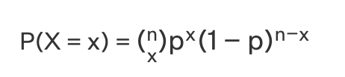
Binomial distribution
The binomial distribution describes the number of successes in a fixed sequence of discrete independent trials, each with a constant probability of success (p).
These trials are experiments that can have only two outcomes, i.e, success (with probability p) and failure (with probability 1 - p).
E.g. Three die are rolled. What is the probability that of getting two sixes?
The Probability Mass Function (PMF) of the binomial distribution has to be calculate in this scenario.

Slide 39

Poisson distribution
Poisson distribution models the probability that a given number of events will occur within an interval of time independently and at a constant mean rate.
The probability mass function of Poisson distribution with parameter λ (average rate)
The Probability Mass Function (PMF) of the poisson distribution is given by the formula below.
Poisson gives an approximation by counting occurrences
The Poisson distribution is preferable to the binomial distribution when n is large and p is small

Slide 40
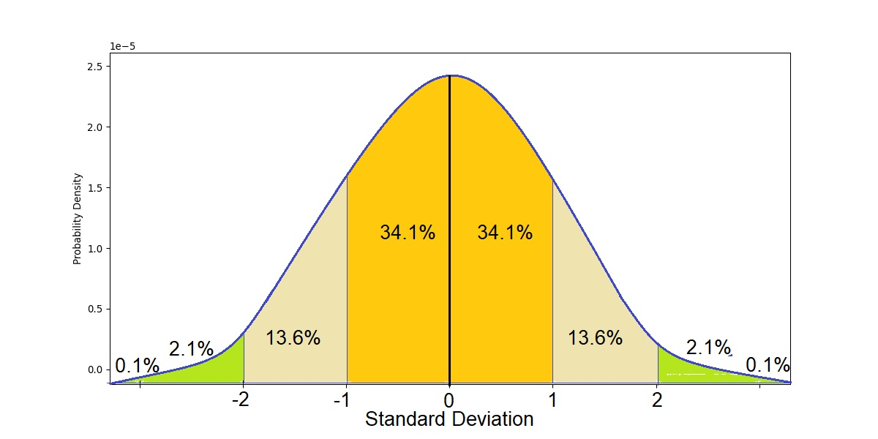
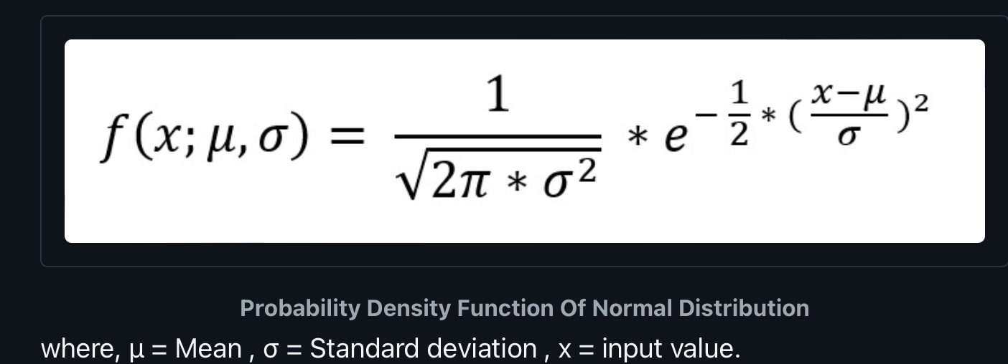
Normal distribution
Also called Gaussian distribution or “bell” curve
Normal distribution makes the following assumptions;
The mean, mode, and median are all equal.
The total area under the curve is equal to 1.
The curve is symmetric around the mean.
Calculate using the Probability Density Function (PDF)

Slide 41
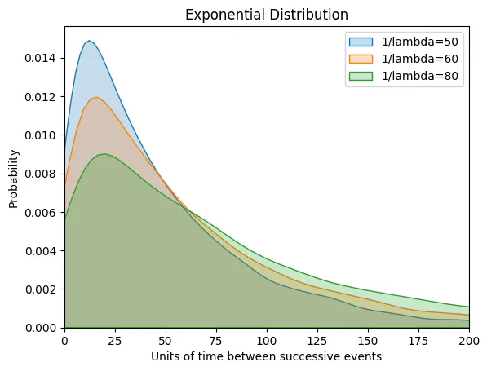
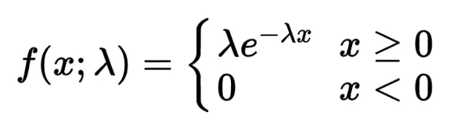
Exponential distribution
Models the time between occurrences of a Poisson event (or successive events) and suited to continuous variables
Parameter: λ: Rate parameter (inverse of the mean)
Example: Time between arrivals of customers at a store
Below is the PDF formula;

Slide 42
Basic concepts of probability
PRACTICUM USING PYTHON IN VISUAL STUDIO

